Slide 1

Student Blockchain Portal
CSC03A3 Mini Project 2024 by 220072437

Slide 2
Table of contents
Problem Statement
01
02
Solution
The issues currently faced by students and the institution
How the blockchain will solve our problem
03
Overview
04
Demonstration
Solution and application overview
Showing the application in action
05
Screenshots
Look and feel of the UI

Slide 3
Problem Statement
01

Slide 4

The Problem
Students do not have a convenient way to submit valid documents, view course progression, and the university administration incorporates a tedious way to verify these documents:
The submission of fake sick notes causes problems for university admin.
Students can’t effectively track and visualize their performance from each assessment.
The submission of SRC votes is inconvenient and can lead to fake votes being submitted.

Slide 5
Solution Statement
02

Slide 6
The Solution
A Student Portal
The Blockchain
An application where students can submit their sick notes, submit SRC votes and closely track their course progression.
This application will make extensive use of the blockchain to ensure that all documents submitted will be valid.

Slide 7
Benefits of this Solution
Convenient
Modern
Secure
It is an easier way to submit and verify documents.
Uses Web 3.0 technology and advanced data structures.
Using the blockchain builds a foundation of trust and assurance,
Efficient
Tamper Proof
Relevant
Reduces time needed to verify documents.
The use of the blockchain ensures that fraud is impossible.
Solves a real-world problem faced by students and admin alike.

Slide 8
Application Overview
03

Slide 9

Submission of Sick Notes and Affidavits
The main use case of this application will be the submission, vetting, and approval of sick notes and affidavits for deferred assessment applications.
Students will submit their documents on their profiles, and the admin will examine and determine whether their application has been successful or not through a vetting process.

Slide 10
Additional Functions
Course Tracking
SRC Voting
Students can view course details and their performance.
Students can conveniently vote in SRC elections
Notices
Monitoring
Submissions will be stored and tracked whether they are successful or not.
Students and Admin will be notified of any submissions and of the outcomes of previous submissions.

Slide 11
Application Demonstration
04

Slide 12
Screenshots
05

Slide 13
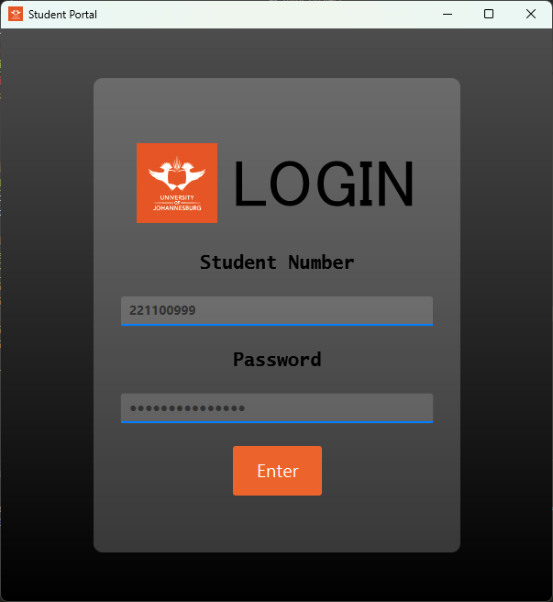
Login Page

Slide 14
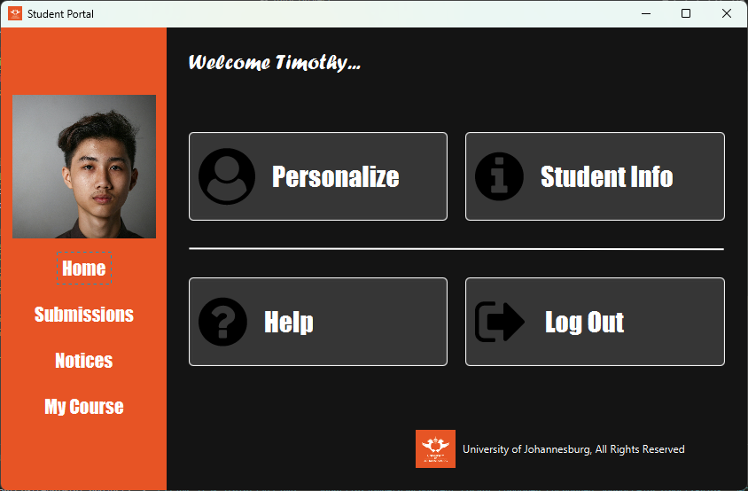
Home Page

Slide 15
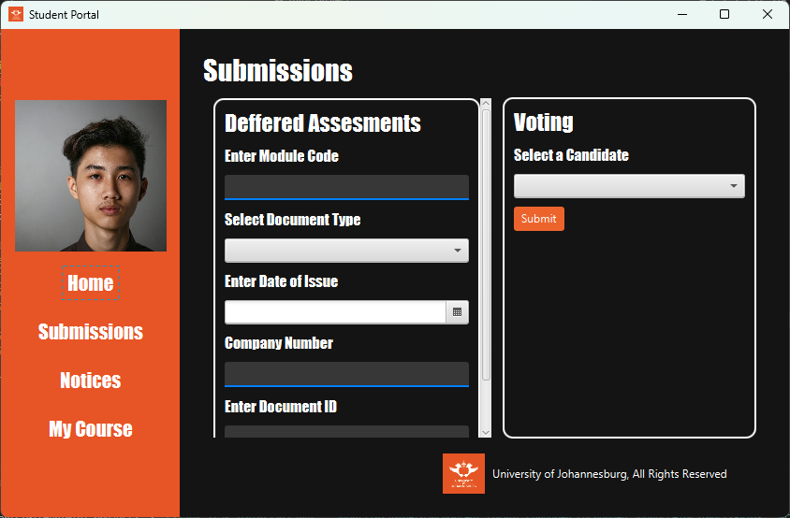
Submissions

Slide 16
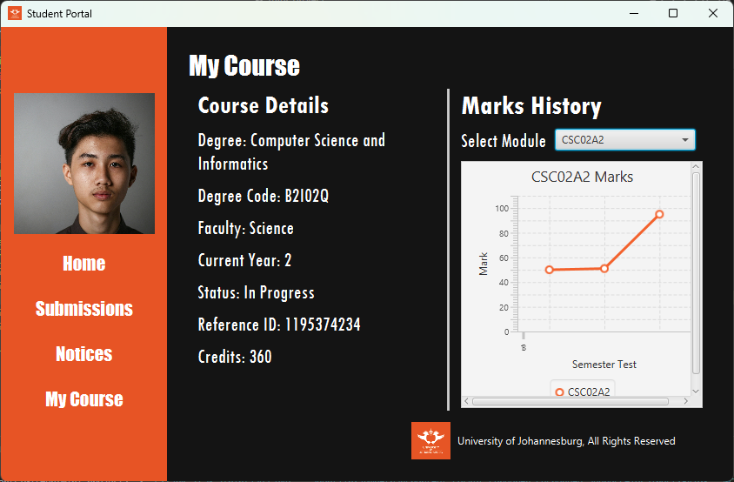
My course page

Slide 17
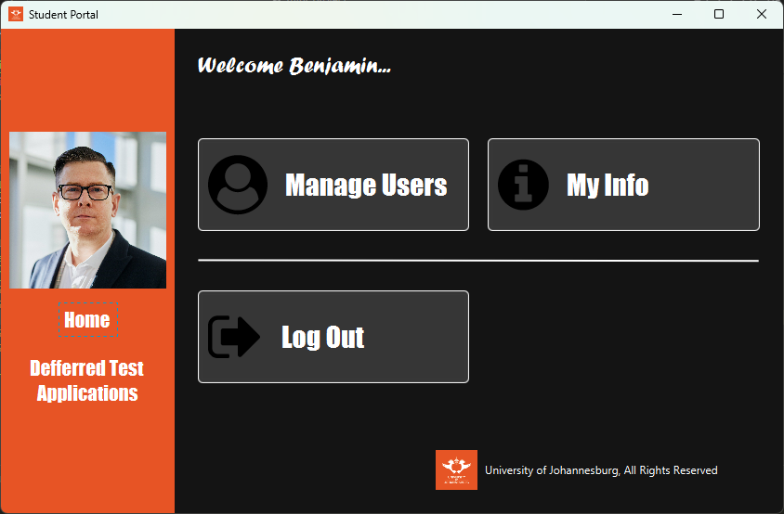
Admin dashboard

Slide 18
Thanks!
Please keep this slide for attribution

